Slide 1
‘A Question of’ …Nine Number Picture Boards
This nine number picture board is adapted from a template available from www.sln.org.uk/geography
Click a number to link to an image
Click the image to link to an information page
Click the yellow square to link back to the image
Click the red square to link back to the picture board
Once selected, numbers will change colour

Slide 2
A Question of Rivers
1
2
3
4
5
6
7
8
9

Slide 3
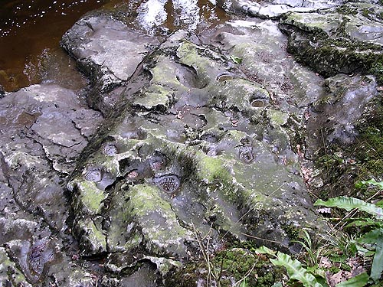
1
How were the little circular depressions in the bedrock of this river formed?

Slide 4
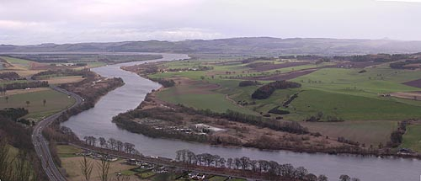
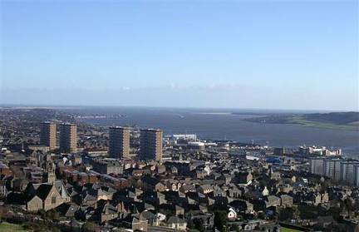
2
This is Scotland’s longest river. Which river is it? Into which body of water does it flow? Scotland’s fourth largest city is located on its estuary? Which city is it?

Slide 5
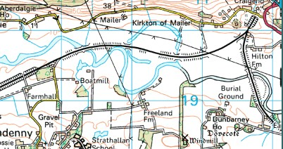
3
Image produced from the OS Get-a-Map service.
Image reproduced with kind permission of the OS and OS of Northern Ireland
Describe the physical features of the river and its valley

Slide 6
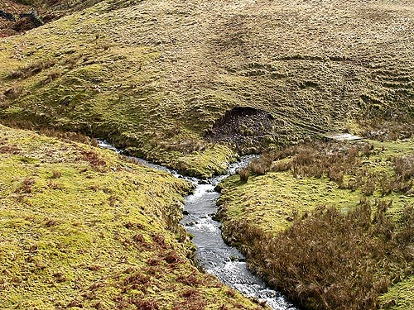
4
What river feature occupies the centre of this photo? How does the river change downstream of the feature?

Slide 7
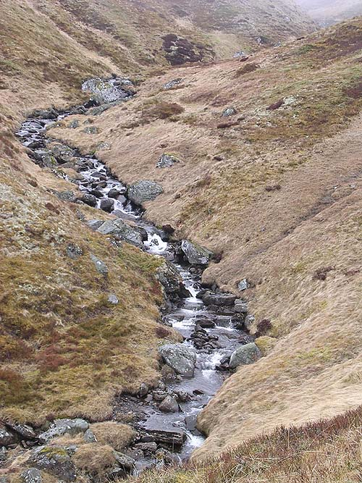
5
What features identify this stretch of river as part of its upper course?

Slide 8
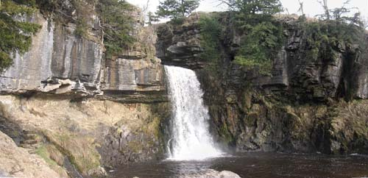
6
Why has a waterfall developed here?

Slide 9
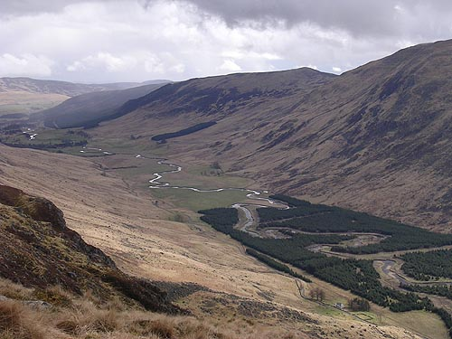
7
How would you know that this valley was not carved by the river which flows in it today?

Slide 10
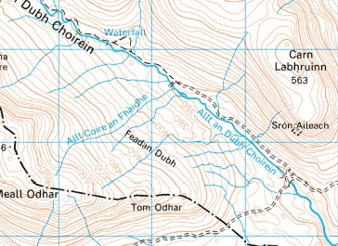
8
Image produced from the OS Get-a-Map service.
Image reproduced with kind permission of the OS and OS of Northern Ireland
Describe the physical features of the river and its valley

Slide 11
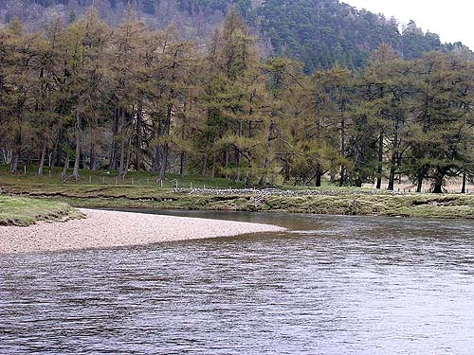
9
Describe and explain the differences between the sides of the river

Slide 12
The circular depressions are little pot holes.
Small stones are swirled around in them when the river is flowing higher and faster than it is at present.
The pot holes are eroded by the abrasive action of the swirling stones.

Slide 13
The photo shows the River Tay which at 117 miles is Scotland’s longest river.
It rises only 25 miles from the west coast but flows east to its mouth on the North Sea.
Although many English rivers e.g. the Severn and theThames are longer than the Tay, the Tay carries a greater volume of water than any other British river.
Dundee is located on its estuary.

Slide 14
ox bow lake
broad, flat flood plain
gentle long profile
meanders
limit of tidal influence
river channel more than 8m
embankments/levees

Slide 15
This feature is a confluence. It occurs where a tributary joins the main stream or river.
Downstream of a confluence , the river increases in width. The discharge of a river (the volume of water it is carrying) also increases significantly.

Slide 16
interlocking spurs
steep valley sides
steep long profile
absence of flood plain
large bedload

Slide 17
An overhang develops where the softer rock below is eroded. In time this will collapse.
relatively softer rock
a band of hard rock interrupts the river’s course
plunge pool

Slide 18
This valley is a U-shaped valley in the Scottish Highlands. It was eroded by ice during the Ice Age.
It is much too large and deep to have been carved by the small river which now flows in it.
The river is called a ‘misfit’ as it is not in keeping with the scale of its valley.
Although the river is in a highland valley, it displays features of a valley in its lower course (meanders). This is because the valley floor is so flat.

Slide 19
many small tributaries
steep valley sides
no flood plain
river channel less than 8m wide
steep long profile
river follows a relatively straight course

Slide 20
9
On the inside of the meander water is flowing more slowly. This results in deposition and the formation of the slip-off slope or river beach.
On the outside of the meander water is flower more quickly. This results in erosion and the formation of a cut bank or river cliff.

Slide 21
This powerpoint was kindly donated to
www.worldofteaching.com
http://www.worldofteaching.com
Is home to well over a thousand powerpoints submitted by teachers. This a free site. Please visit and I hope it will help in your teaching
Notes:
21

